Slide 1


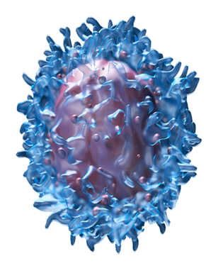
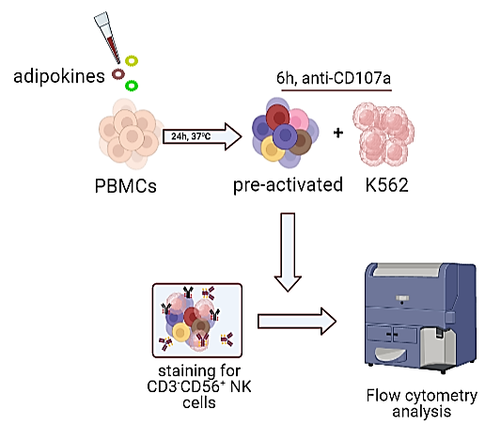
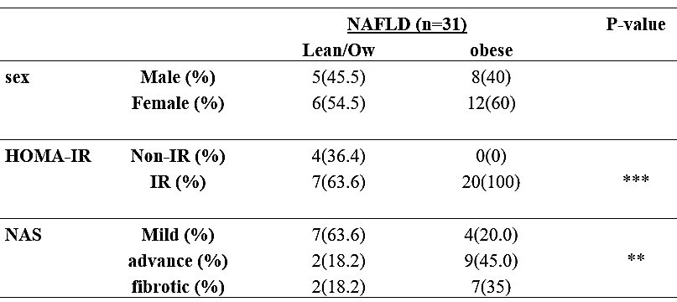
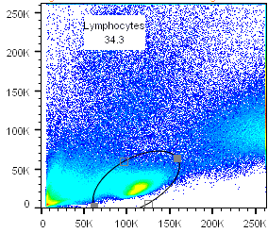
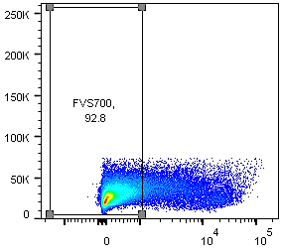
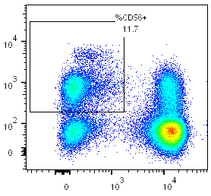
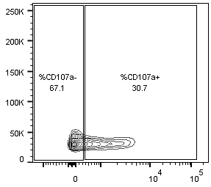
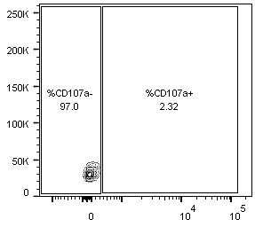
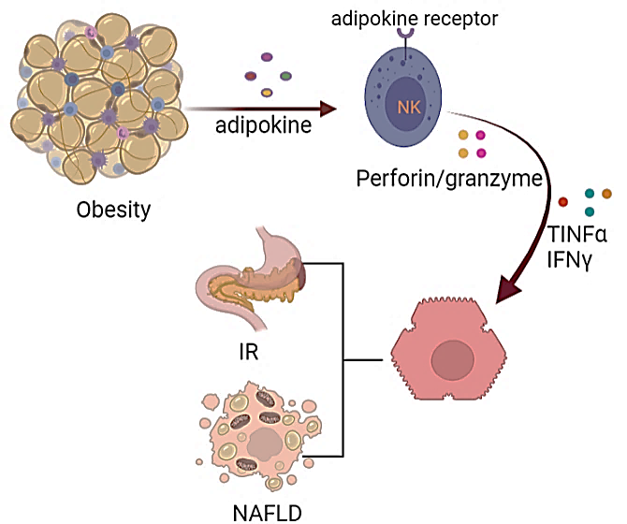
The role of adipokines in obesity-mediated NK cell dysregulation
Gaitan Fabrice Njiomegnie^{1,2}, Ratna Wijaya², Jacob George^{2,4}, Scott A. Read^{1,2,3,4}, Golo Ahlenstiel^{1,2,3,4}
¹Blacktown Clinical School and Research Centre, Western Sydney University,, ²Storr Liver Centre, Westmead Institute for Medical Research, ³Blacktown Hospital, ⁴Westmead Hospital, University of Sydney.
Obesity: a risk factor for many diseases and chronic conditions
MAFLD cohort characterisation
NK cell responses to adipokines
I. Degranulation
Our study will utilise a cross-sectional cohort of patients with biopsy-proven MAFLD (n=31). We stratified our cohort based on body mass index into lean, overweight (Ow) and obese subgroups and compared insulin sensitivity (HOMA-IR: non-IR<2.0, IR>2.0) and histological injury using the NAFLD activity score (NAS: mild <2, advanced 3-4, fibrotic ≥5).
Metabolic Associated Fatty Liver Disease (MAFLD) is a heterogeneous multifaceted liver complication, affecting a quarter of the world population, the majority being obese (1). In 2017, ~2.8 million people worldwide died due to obesity-related complications (diabetes, fatty liver, cardiovascular disease [CVD]) (2). In Australia, over 67% of the adult population (>12.5million) is overweight, a proportion that has been increasing steadily since the 1990’s (Figure 1) (2) .
PBMCs from healthy and MAFLD patients where isolated from whole blood using Ficoll plaque density gradient centrifugation. PBMCs where pre-treated for 24 h with adipokines followed by co-culture for 6 h with K562 target cells that lack MHCII expression, thus acting as an activation stimulus for NK cell degranulation. Cytotoxicity was measured using the CD107a marker that becomes expressed on the NK cell surface following degranulation. Flow cytometry gating was performed on live lymphocytes, followed by the CD3- CD56+ population to identify NK cells. The percentage and intensity (mean fluorescence intensity, MFI) of CD107a+ NK cell was used to measure degranulation.
Figure 1: The increase in prevalence of obesity in adult Australians from 1995 to 2018.
Figure 4. Experimental setup to assess NK cell degranulation following adipokine treatment.
Obesity stimulates low grade chronic inflammation, altered immune cell phenotypes (e.g., natural killer (NK) cells), and causes a dysregulation of fat-derived cytokines (adipokines) (3). This may lead to steatohepatitis and insulin resistance (IR) (4). Still, it is unclear if adipokines modulate NK cell metabolism and functionality in obese patients. We hypothesize that dysregulated adipokine levels in obese patients alter NK cell phenotype and metabolic functions contributing to many of the complications arising from obesity.
lymphocytes
Live cells
CD3-CD56+ NK
%CD107a+
Table 1. Our cohort consisted primarily of female and obese patients. Using HOMA-IR, a significant difference for IR is seen, with more obese patients presenting with insulin resistance than their lean counterparts. Liver injury was also significantly more severe among obese patients when compared to lean patients. This is consistent with previous study (5).
SSC
SSC
CD56
FSC
FVS700
CD3
adipokines
CD107a+ NK
CD107a+ NK
Figure 6. Selected adipokines increase NK cell degranulation against K562 target cells.
Objectives
Adipokine treatments were performed at high (H), low (L) concentrations and compared against mock treated (pos) and a negative (neg) control without K562 co-culture. Our preliminary results on healthy PBMCs show that a subset of adipokines (chemerin (H), omentin(H &L) and visfatin (H)) increase the cytotoxic response of NK cells against K562 target cells.
We aim to understand how obesity dysregulated adipokines such as adiponectin, leptin, chemerin and omentin alter natural killer (NK) cell phenotype. Defining NK cell dysregulation in obesity may help identify new therapeutic targets to reduce mortality associated with obesity and improve quality of life.
SSC
CD107a
Figure 5. Gating strategy to measure NK cell CD107a expression.
The red boxes in figure 5 shows the cells included in our analysis. CD107a+NK cells in green show an increase in frequency when co-cultured with K562 cells as opposed to the negative control CD107a+NK cells without co-culture.
Figure 3: Correlation between NAS and HOMA-IR / insulin in MAFLD patients.
Future plans
- Quantification of adipokine receptor expression on healthy vs NAFLD NK cells.
- Comparison of adipokines on healthy, NAFLD obese and NAFLD lean subjects via cytotoxicity, proliferation, and immunometabolic assays.
- Phenotype blood and liver NK cells in obese vs healthy patients using a panel of 30 NK markers relating to activation status, residency and cytotoxic potential.
References
1. Eslam et al. A Consensus-Driven Proposed Nomenclature for Metabolic Associated Fatty Liver Disease. Gastroenterology Vol. 158, No. 7 (2020)
2. Overweight and obesity - Australian Institute of Health and Welfare. 2020.
3. Saeidi et al., 2020 . The effects of physical activity on adipokines in individuals with overweight/obesity across the lifespan: A narrative review.
4. Liu, Z. et al. Causal relationships between NAFLD, T2D and obesity have implications for disease subphenotyping. J. Hepatol. 73, 263–276 (2020)
5. Theurich, S. et al. IL-6/Stat3-Dependent Induction of a Distinct, Obesity-Associated NK Cell Subpopulation Deteriorates Energy and Glucose Homeostasis. Cell Metab. 26, 171-184.e6 (2017)
6. Isokuortti, E. et al. Use of HOMA-IR to diagnose non-alcoholic fatty liver disease: a population-based and inter-laboratory study. Diabetologia 60, 1873–1882 (2017)
Figure 2: Adipose tissues releasing adipokines, stimulating NK cells activated which leads to excessive production of pro-inflammatory cytokine production, promoting insulin resistance and NAFLD in obese patients.
MAFLD patients present with excess fat in the liver (steatosis). Excess fat is a major contributor to both IR and liver injury in these patients. To examine this relationship in lean/Ow versus obese patients, we correlated NAS vs insulin and HOMA-IR. Our findings show a significant and positive correlation in Lean/ Ow patients. A weak positive and significant correlation is seen for HOMA-IR in obese patient. No significant correlation for insulin in obese patients was observed. Our findings suggest that HOMA-IR is a better indicator for IR in MAFLD and is consistent with previous studies (6).
Study aims include:
Aim 1: Identifying NK sensitivity
to individual adipokines.
Aim 2: Examining the immunomodulatory effect of adipokines on NK cells using degranulation, proliferation, cytokine production and metabolic assays.

